Slide 1


Episode 2
Financial Projection
Part 1
Salem Al Mutawa Chief Operating Officer - COO

Slide 2

Financial Projection
What is a FINANCIAL PROJECTION?

Slide 3
Contd. FINANCIAL PROJECTION
Definition: A forecast of future expenses and revenues.
(Usually amended according to who it’s prepared for.)

Slide 4

Contd. FINANCIAL PROJECTION
Types of Financial Projections (time period):
Short-Term: 3 – 5 years projection
Long-Term: 5+ years projection

Slide 5
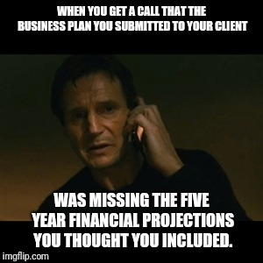
Contd. FINANCIAL PROJECTION
Values & Importance of Financial Projection:

Slide 6
Contd. FINANCIAL PROJECTION
Values & Importance of Financial Projection:
ADDRESS IF THE BUSINESS IDEA IS FEASIBLE OR NOT?
HOW TO MAKE IT FEASIBLE?
AID FOR EFFICIENT BUSINESS SET UP & BE COST EFFECTIVE
KNOW THE INTERNAL ISSUES OF EXISTING COMPANIES.

Slide 7
Contd. FINANCIAL PROJECTION
Values & Importance of Financial Projection:
IDENTIFY TOTAL STARTING CAPITAL REQUIRED
NUMERICAL GUIDANCE FOR BUSINESS PLAN

Slide 8

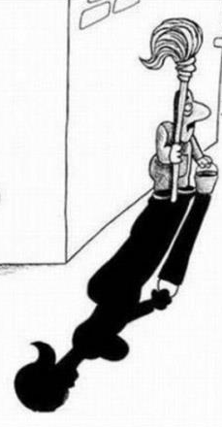



Contd. FINANCIAL PROJECTION
Factors to consider while building a Financial Projection:
BE CONSERVATIVE IN COSTING
MAKE REALISTIC REVENUE ASSUMPTIONS
AT LEAST 3 SUPPLIER QUOTATIONS
BE CONSISTENT
NUMBERS SHOULD BE JUSTIFIED FROM CREDIBLE SOURCES

Slide 9
CAPEX OPEX
Definition
Breakdown:
Assets
Non-recurring expenses
Working Capital
© Copyright This document is confidential and is the property of Cubical Services Company. All rights reserved. Neither the whole nor any part of this/her document may be disclosed to others or reproduced, stored in retrieval system or transmitted in any form by any means (electronic, mechanical, reprographic recording or otherwise) without prior written consent of Cubical Services Company.

Slide 10
CapEx OpEx
Capital Expense (CapEx): The amount of money utilized to purchase major goods and/or services that will be used for more than one year.
Operational Expense (OpEx): The costs needed to run the business’s operations on a daily basis.

Slide 11
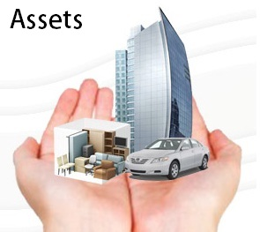

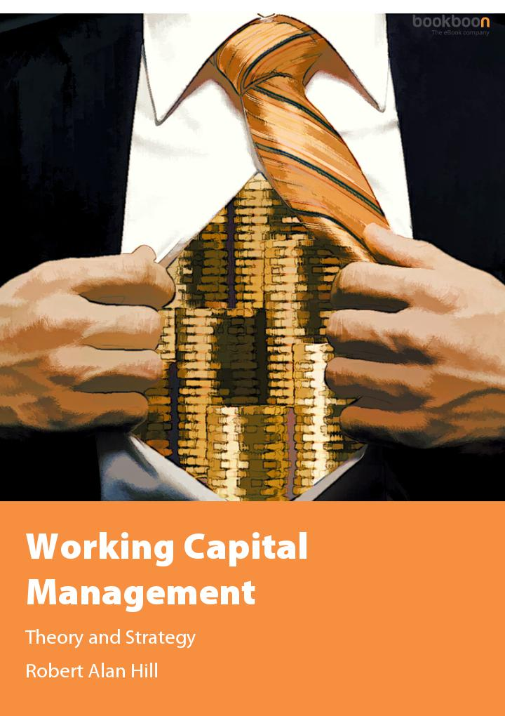

Contd. CAPEX OPEX
Breakdown of Start-up Capital Required:
Assets
CAPEX
Non-Recurring Expenses
Working Capital:
Fixed Monthly Operation Expenses
No. of Months Required
Inventory & Raw Materials (If Applicable)
OPEX

Slide 12
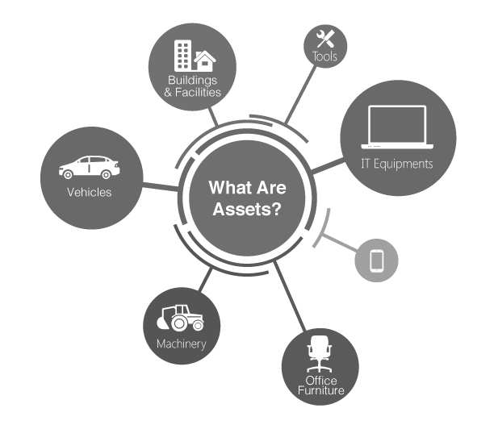
Contd. CAPEX OPEX
Breakdown of Start-up Capital Required:
Assets
Item of property that are resources owned by a company and which have future resale value
Types of Assets: -Tangible Assets -In-Tangible Assets i.e. Online development

Slide 13


Contd. CAPEX OPEX
Breakdown of Start-up Capital Required:
Non-Recurring Expenses:
Uniform
Costs that occur on a *one-time basis* and are unlikely to occur again in the normal course of business.
Branding
Company Establishment
Designing

Slide 14
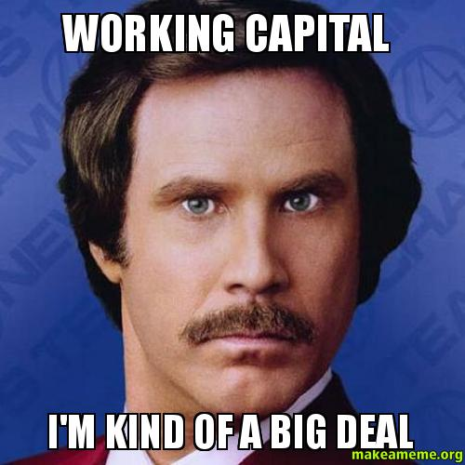
Contd. CAPEX OPEX
Breakdown of Start-up Capital Required:
Working Capital:
The capital required for a business which is used in its day-to-day trading operations.

Slide 15

Contd. CAPEX OPEX
Breakdown of Start-up Capital Required:
Working Capital:
Fixed Monthly Operation Expenses
No. of Months Required (based on business module)
Inventory & Raw Materials (If Applicable)
Formula = (a x b)+c

Slide 16
Contd. CAPEX OPEX
Breakdown of Start-up Capital Required:
Fixed Monthly Operation Expenses:
Rent:
An Estimate area size required
Location
Estimated cost per sq.m (based on the location)
Rent = a x c
Example:
Area size: 500sq.m
Location: Al-Hamra Tower
Estimated cost per sq.m: KWD10
Rent = 500 x 10 = KWD 5,000 (monthly)
Salary:
Job description
Position
No. of employees required (based on the business concept)
Salary based on the average market

Slide 17
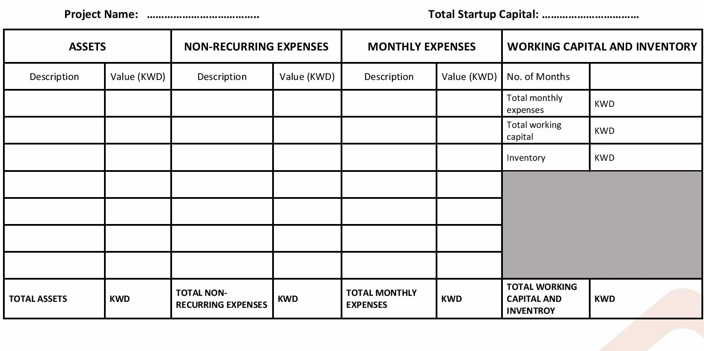
Example:
SALEM GYM
KWD 36,650
6
Equipment
1,000
Branding
3,000
Rent
400
4,000
X
Machinery
2,000
Consultancy
650
Salaries
3,600
=
24,000
+
Furniture
2,000
1,000
App. Develop
3,000
8,000
3,650
4,000
25,000
=

Slide 18
Workshop :
Assets
Construction
Furniture + Fit-out
Equipment
Delivery Van
Computer Systems
Online Platform
Appliances
Office Accessories
Mobile devices
Security Cameras
Employee Attendance Machine
Non-Recurring Expenses
Company Establishment
Branding & Logo
Interior Design
Demolition
Cleaning Services
Curtains Set-up
Plants Set-up
Domain Purchase Set-up
Location commission
Insurance Expense
Monthly working capital
Rent
Employee Salaries
Accounting Service
Upay Payment Gateway
POS Software Subscription
Internet Services
Utilities
Legal Consultancy Services
Social Media Management

Slide 19
Until Next Time…
Stay Tuned for the Next Episode…
Thank You…
© Copyright This document is confidential and is the property of Alliance Company. All rights reserved. Neither the whole nor any part of this/her document may be disclosed to others or reproduced, stored in a retrieval system or transmitted in any form by any means (electronic, mechanical, reprographic recording or otherwise) without the prior written consent of Alliance Company.

